Slide 2
Shuo Wang
Shuo Wang

Slide 3
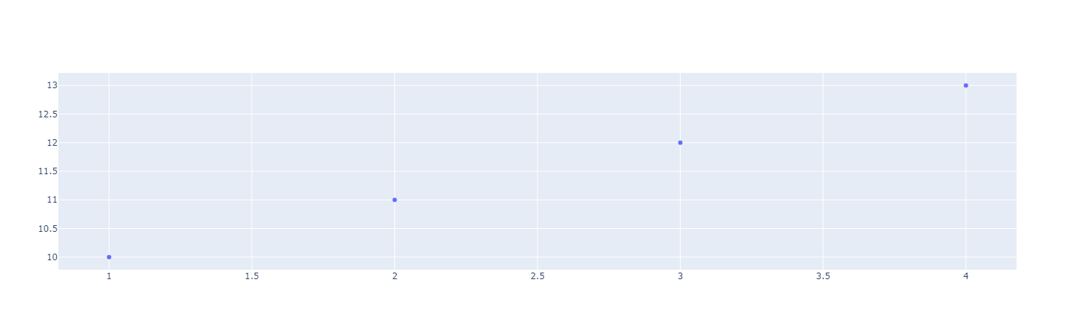
Textbox
This is a second paragraph.
This is a third paragraph.

